Slide 1
Training tips
Iryna Kuchma, Open Access Programme Manager
Attribution 4.0 International

Slide 2
Introduction to pedagogy and training design
Adapted from the EOSC Synergy Train the Online Trainer course
Helen Clare, Jisc & Linas Cepinskas, DANS
EOSC-SYNERGY receives funding from the European Union’s Horizon 2020 research and innovation programme under grant agreement No. 857647
Notes:
Welcome to this session on pedagogy and learning design.
My name is Helen Clare from Jisc in the UK and I’ll be running this session with Linas Cepinskas from DANS in the Netherlands. We both work on the EOSC Synergy project where we are creating a train the trainer programme for online learning. This session is adapted from those materials.

Slide 3
How to think about good design
Many models available
ADDIE gives an overarching framework
Other models can be used to guide each stage
Analyse
Design
Evaluate
Implement
Develop

Slide 4
In reality
It’s tempting to jump straight into development
Don’t skip analysis and design
Start here
Analyse
Design
Start here
Evaluate
Implement
Develop
Not here!

Slide 5
In reality
It’s iterative
It’s not always linear
Evaluation at the core
Analyse
Design
Evaluate
Implement
Develop

Slide 6
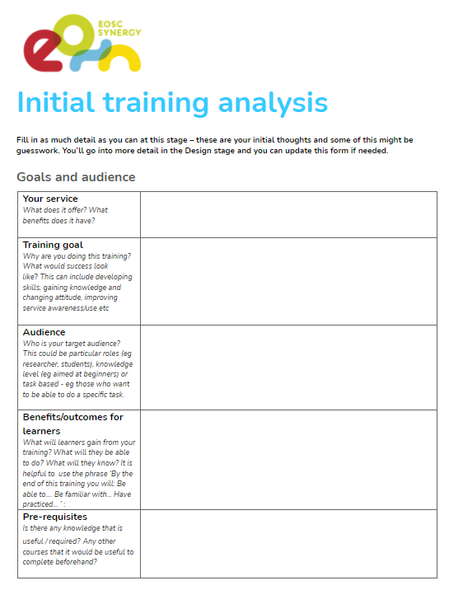
Your initial training analysis
The goals of your training
Topics to cover
Your audience / learners
Learning outcomes
Delivery method
Practical issues

Slide 7
Goals, objectives and outcomes
Goals
The big picture
Improve data management at your university
Objectives
What trainers will do to pursue the goal
Run a series of workshops
Raise awareness of available support services
Outcomes
List the features of a data management plan
Explain why data management is important
Be able to create a DMP
Know where to get support
What learners can do afterwards (evidence of reaching goal)
Adapted from: http://www.drew.edu/sla/outcomes/

Slide 8
Your audience
Role, background and context
Prior knowledge, skills and experiences
Motivation
Barriers / fears

Slide 9
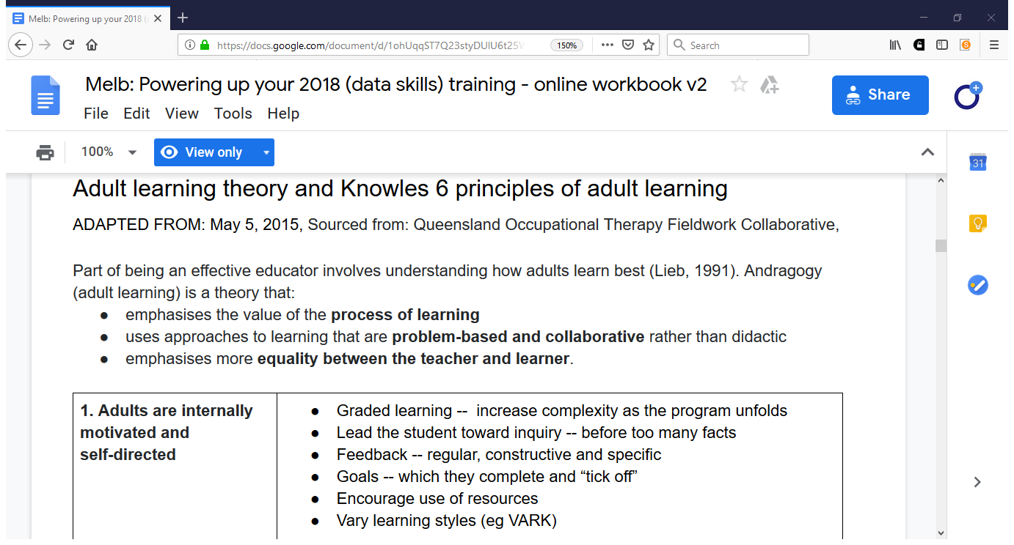

Slide 10
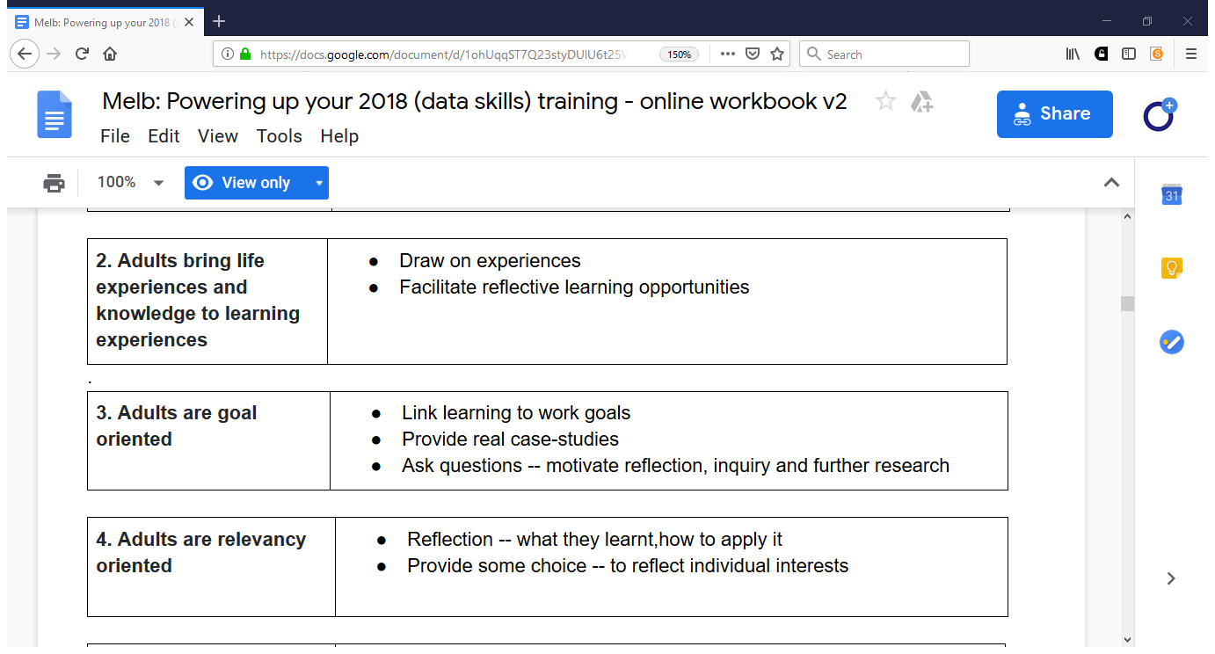

Slide 11
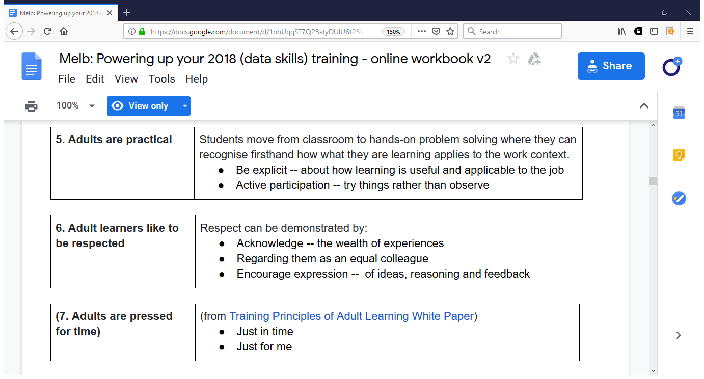

Slide 12
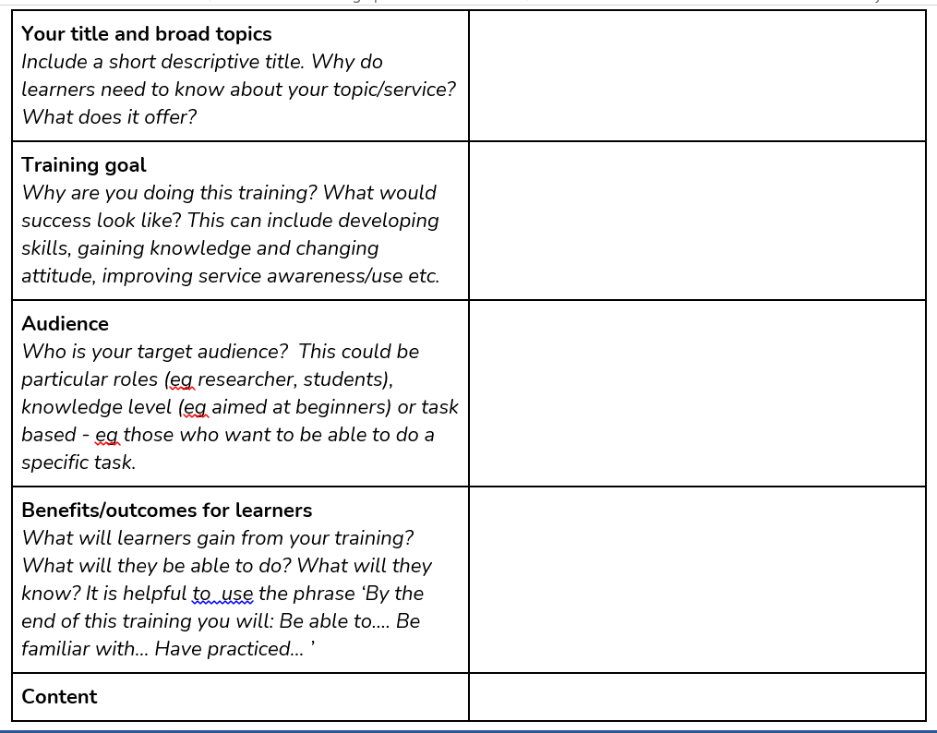
Training analysis worksheet A & B - short versionFile
https://moodle.learn.eosc-synergy.eu/course/view.php?id=132&section=4#tabs-tree-start

Slide 13
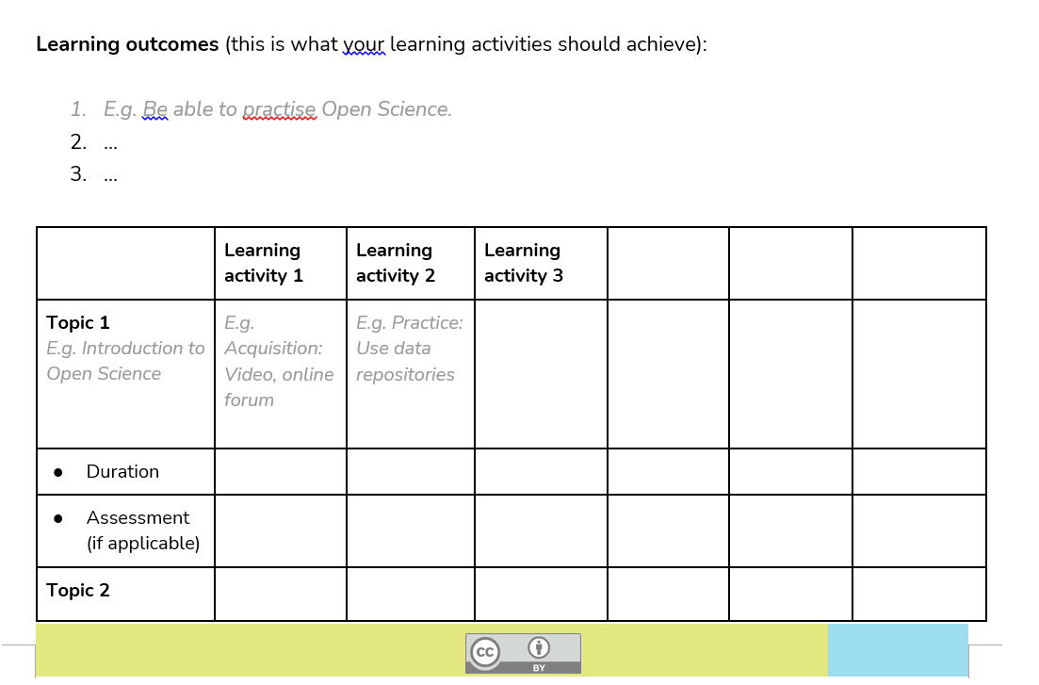
Training analysis worksheet A & B - short versionFile
https://moodle.learn.eosc-synergy.eu/course/view.php?id=132&section=4#tabs-tree-start

Slide 14
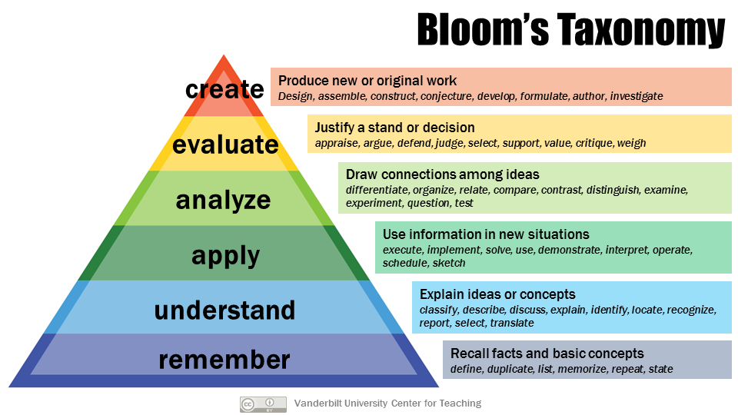

Slide 15
A Taxonomy for Teaching, Learning, and Assessment
Remember
Recognizing
Recalling
Evaluate
Checking
Critiquing
Apply
Executing
Implementing
Understand
Interpreting
Exemplifying
Classifying
Summarizing
Inferring
Comparing
Explaining
Analyze
Differentiating
Organizing
Attributing
Create
Generating
Planning
Producing
Armstrong, P. (2010). Bloom’s Taxonomy. Vanderbilt University Center for Teaching. Retrieved 28/1/2023 from https://cft.vanderbilt.edu/guides-sub-pages/blooms-taxonomy/

Slide 16
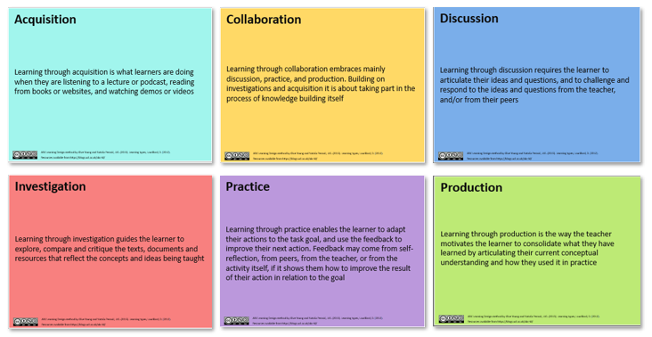
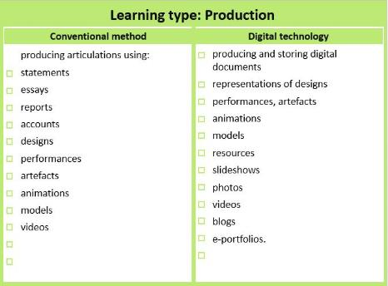
The ABC learning design method
Well established
Quick and simple
Map learner journey
Identify learning type activities
Select specific activities
https://abc-ld.org/

Slide 17
ABC Learning types cards

Slide 18
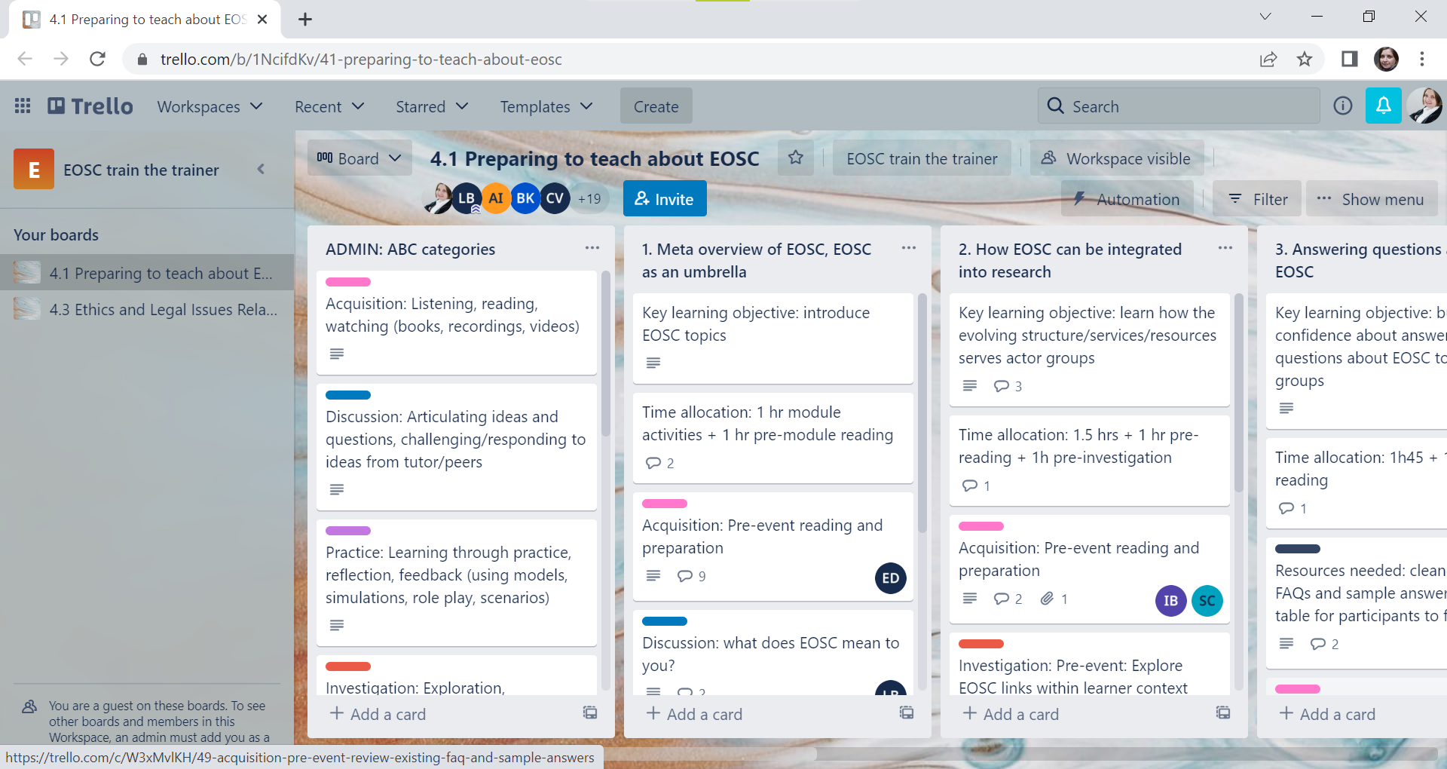

Slide 19
How do you plan your training events?

Slide 20
Finding a place for your training & messages in the competitive research landscape
What methods do you, and could you, use to drive attention to your training activities?
What methods do you, and could you, use to drive up attendance at your training activities - how can you turn REGISTRATION (i.e. interest) into ATTENDANCE (i.e. action)

Slide 21
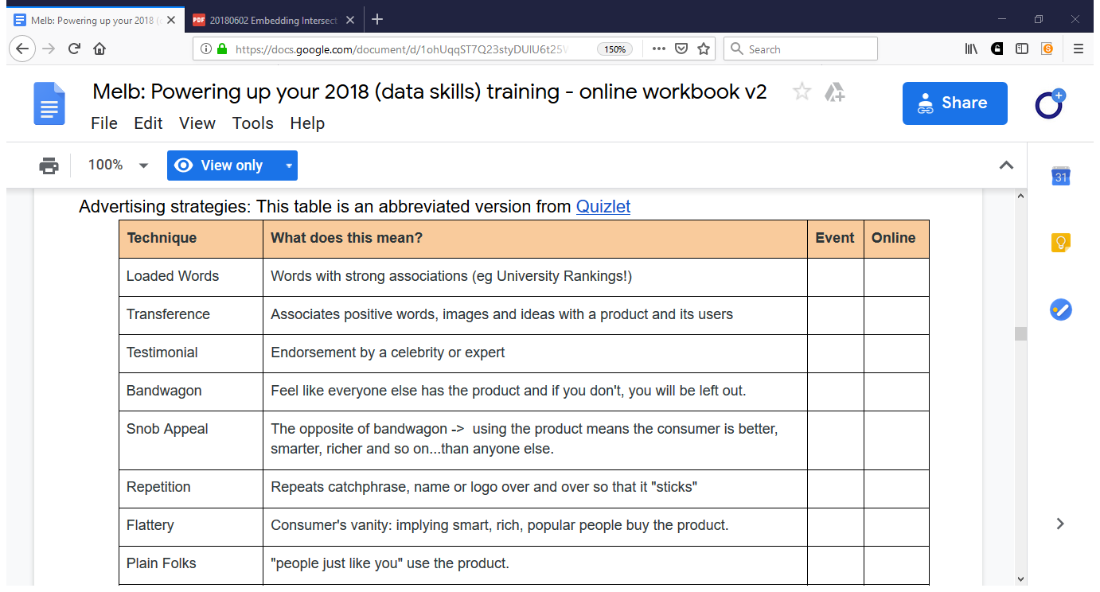

Slide 22
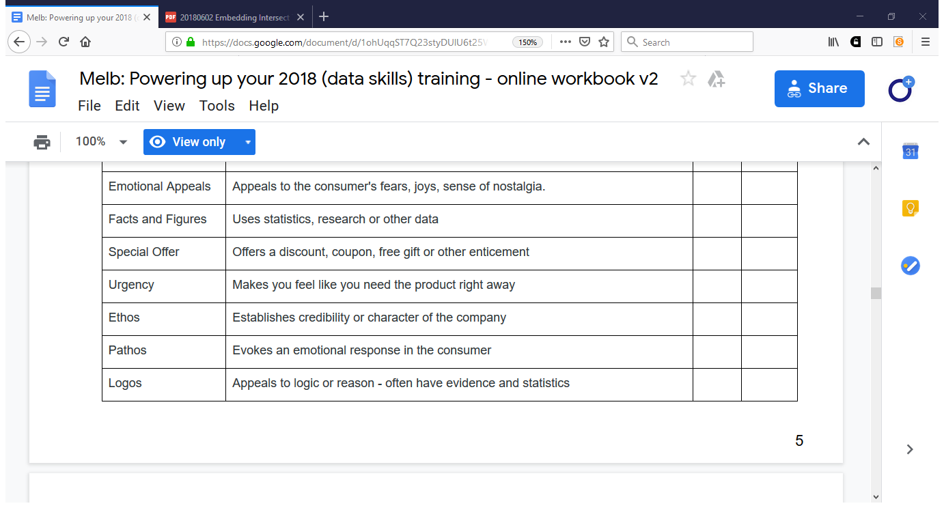

Slide 23
How do you promote your training events?

Slide 24
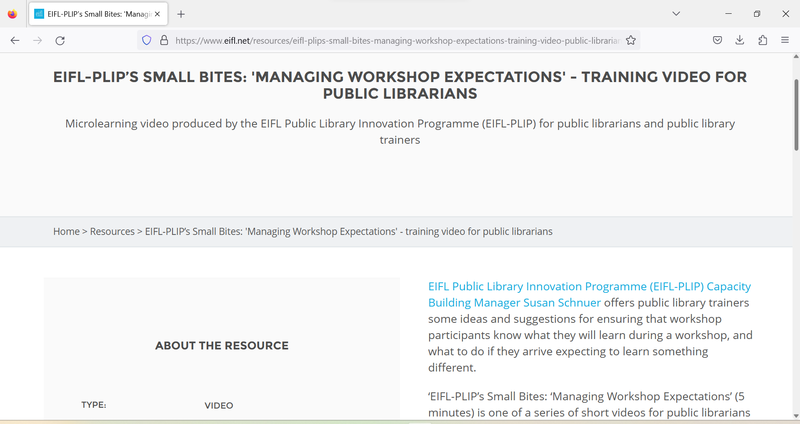
https://www.eifl.net/resources/eifl-plips-small-bites-managing-workshop-expectations-training-video-public-librarians

Slide 25
Evaluation
Different levels of evaluation
Linked to assessment
Needs to be considered in design, not at the end
Results
Behaviour
Learning
Reaction
Kirkpatrick, D. L. (1994). Evaluating training programs: the four levels. San Francisco: Berrett-Koehler.

Slide 26
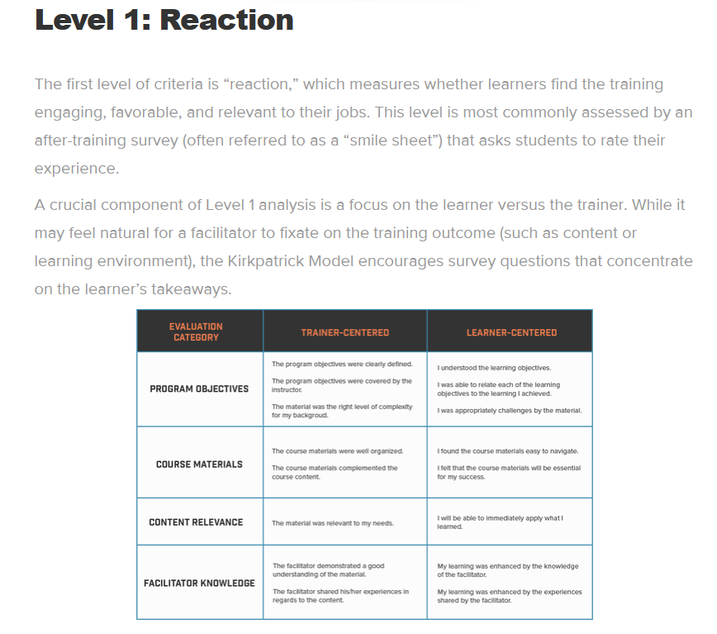
Kirkpatrick model. This model looks at four levels: https://www.ardentlearning.com/blog/what-is-the-kirkpatrick-model

Slide 27
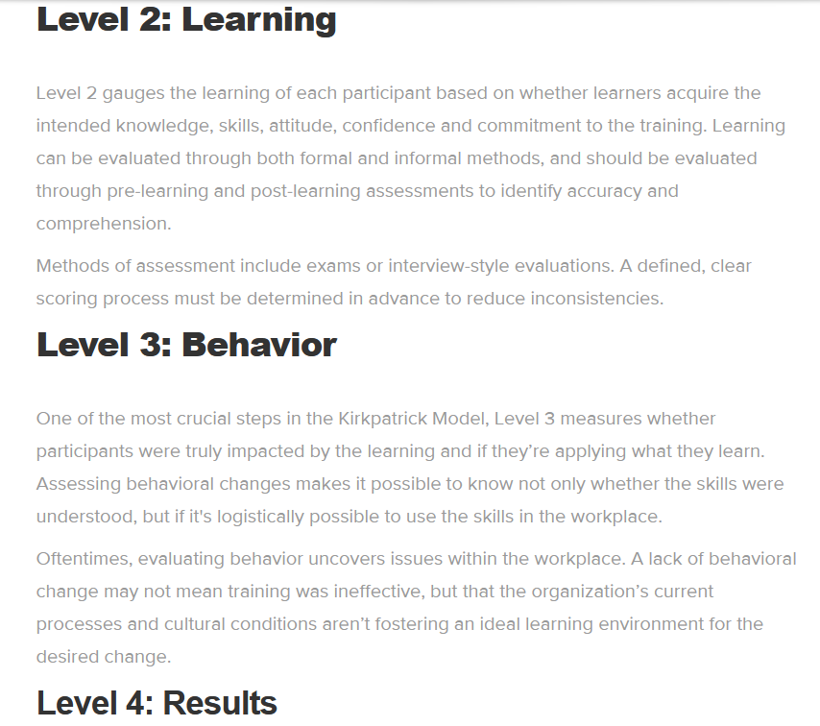
Kirkpatrick model. This model looks at four levels: https://www.ardentlearning.com/blog/what-is-the-kirkpatrick-model
How can we measure skills/community building through time in an ethical way?

Slide 28
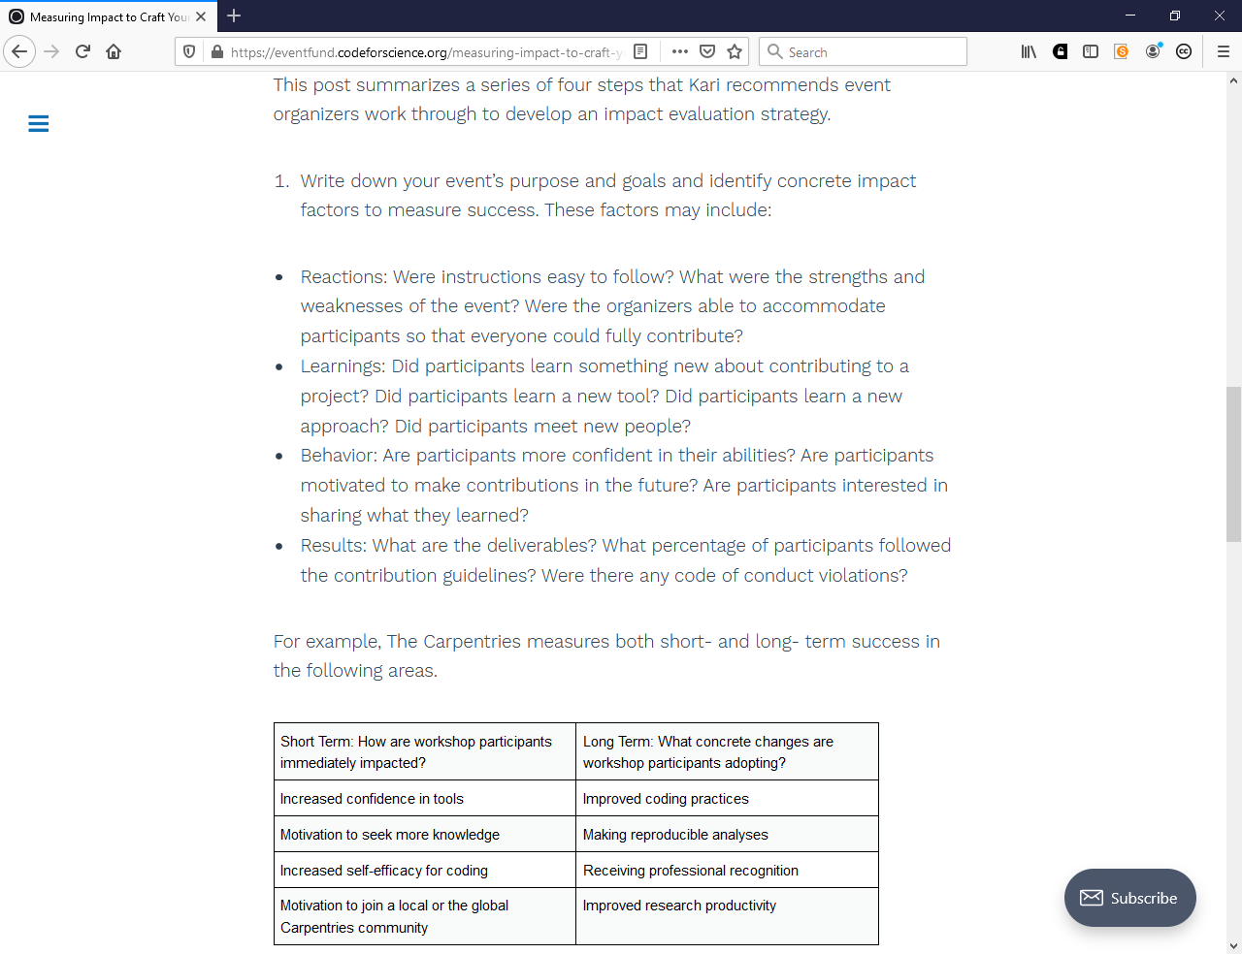
Measuring Impact to Craft Your Story by Dr. Kari L. Jordan, The Carpentries https://eventfund.codeforscience.org/measuring-impact-to-craft-your-story/

Slide 29
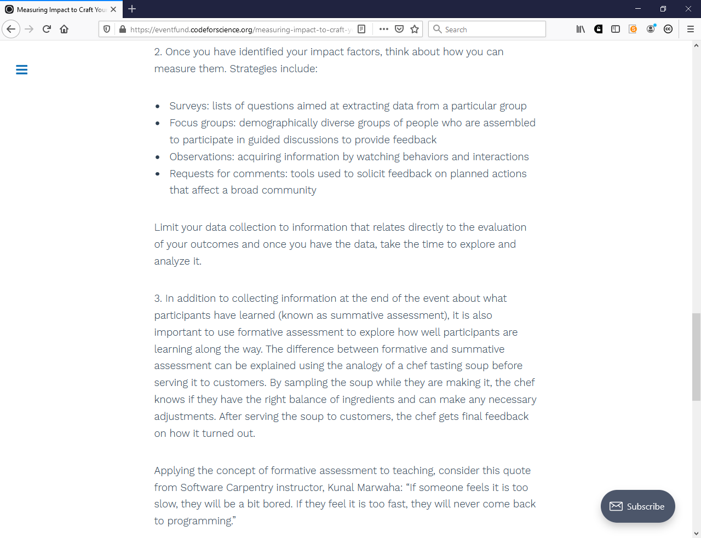
Measuring Impact to Craft Your Story by Dr. Kari L. Jordan, The Carpentries https://eventfund.codeforscience.org/measuring-impact-to-craft-your-story/

Slide 30
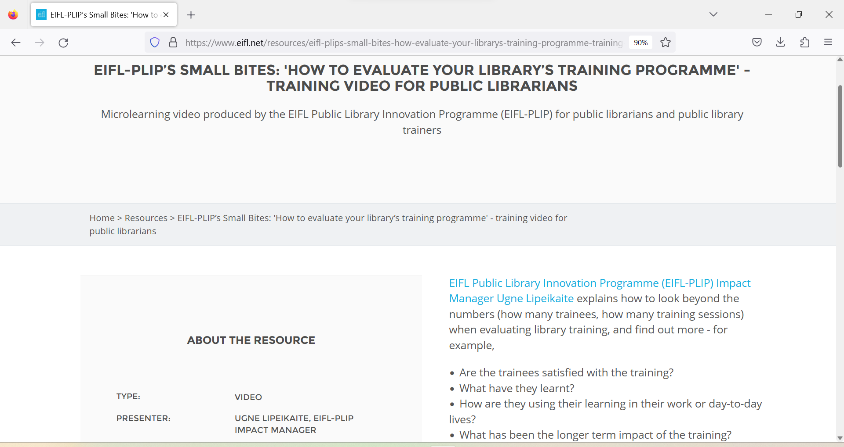
https://www.eifl.net/resources/eifl-plips-small-bites-how-evaluate-your-librarys-training-programme-training-video-public

Slide 31
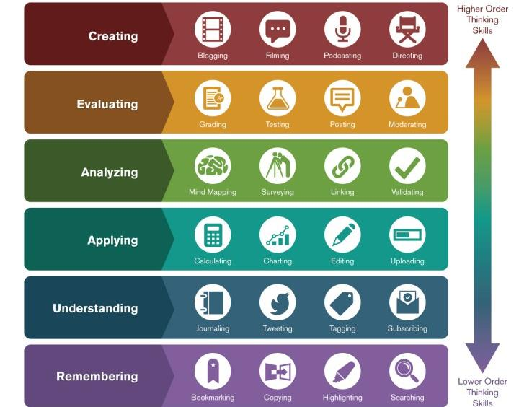
Two points to remember
1. Activities should match the intended outcomes
2. And be engaging and appropriate for learners
Image: Ron Carranza, https://teachonline.asu.edu/2016/05/integrating-technology-blooms-taxonomy/

Slide 32
How do you know if you are making a difference?

Slide 33
How do you evaluate the efficacy & impact of your training?

Slide 34
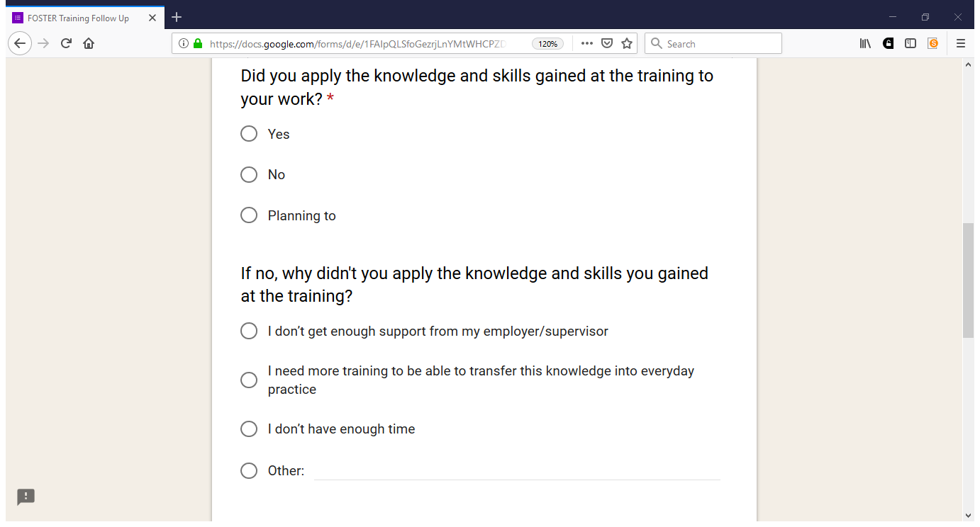

Slide 35
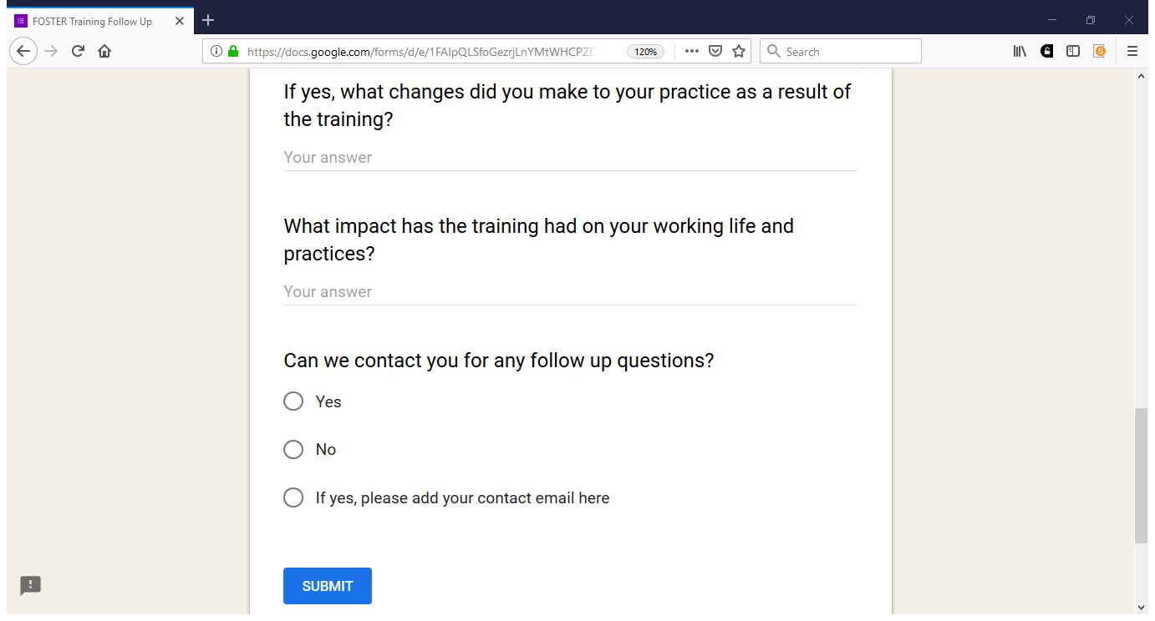

Slide 36
https://open-science-training-handbook.github.io/Open-Science-Training-Handbook_EN//

Slide 37
https://www.openaire.eu/cop-training

Slide 38
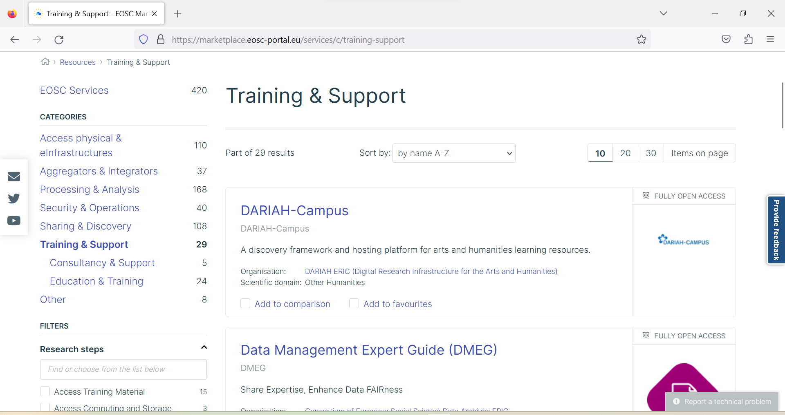
Discover training platforms
https://marketplace.eosc-portal.eu/services/c/training-support

Slide 39
Thank you! Questions?
Contact: iryna.kuchma@eifl.net
@irynakuchma
@irynakuchma@mstdn.social
www.eifl.net

