Slide 1


Episciences overlay journals
EGI 2023
Poznań, Poland
Shaping services for the EOSC: the experience of EOSC Future and the infraEOSC 07 projects
2023-06-21
Raphaël Tournoy
Centre pour la Communication Scientifique Directe
Episciences has received funding from the European Union's under grant agreement OpenAIRE Nexus - OpenAIRE-Nexus Scholarly Communication Services for EOSC users (1010174

Slide 2








> 1 million documents
> 13 000 conferences
27 journals

Slide 3

Overview of motivations and functionalities
Episciences
Quick overview
A platform for publishing open access scientific journals
Diamond open access (free to both authors and readers)
Any disciplines
New or flipping journals
Academic-led and funded
Initiated by researchers for researchers
Cost efficient, relies on existing infrastructures
Publishing toolkit for Scientific communities
CC licences, non-exclusive distribution rights to journals
Free software

Slide 4






Overlay Model
An overlay journal model
Supported
Operating on top of Open Access repositories e.g., arXiv, HAL, Zenodo, … (metadata exchange)
Peer-review of preprints, datasets, softwares
Peer-review : single-blind and open peer-review
Preprints and published articles are hosted only on open repositories
Preprints are immediately available
Compliant with FAIR principles
Ongoing development
Operating on top of OA repositories e.g., arXiv, HAL, Zenodo, …
Peer-review preprints, datasets, softwares
  single-blind review
  open peer-review
Preprints and published articles are hosted only on open repositories

Slide 5
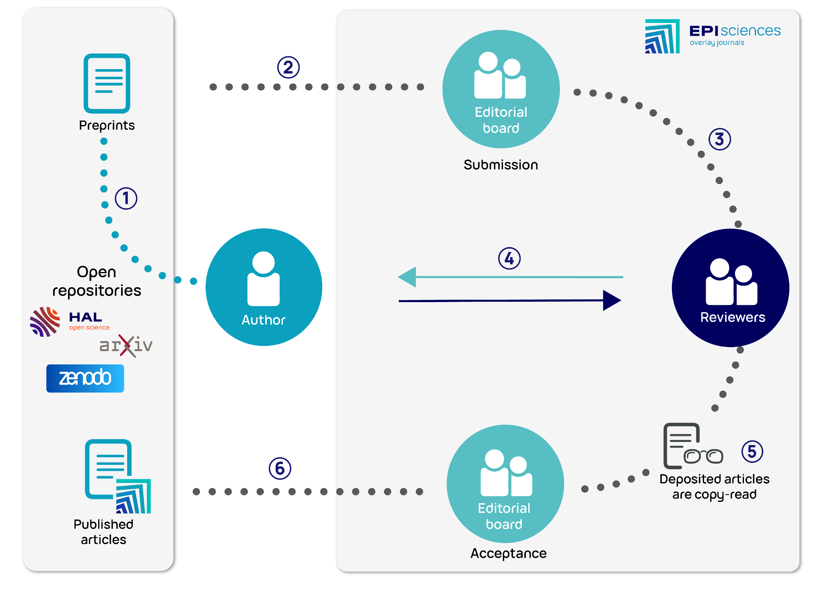
Workflow overview

Slide 6
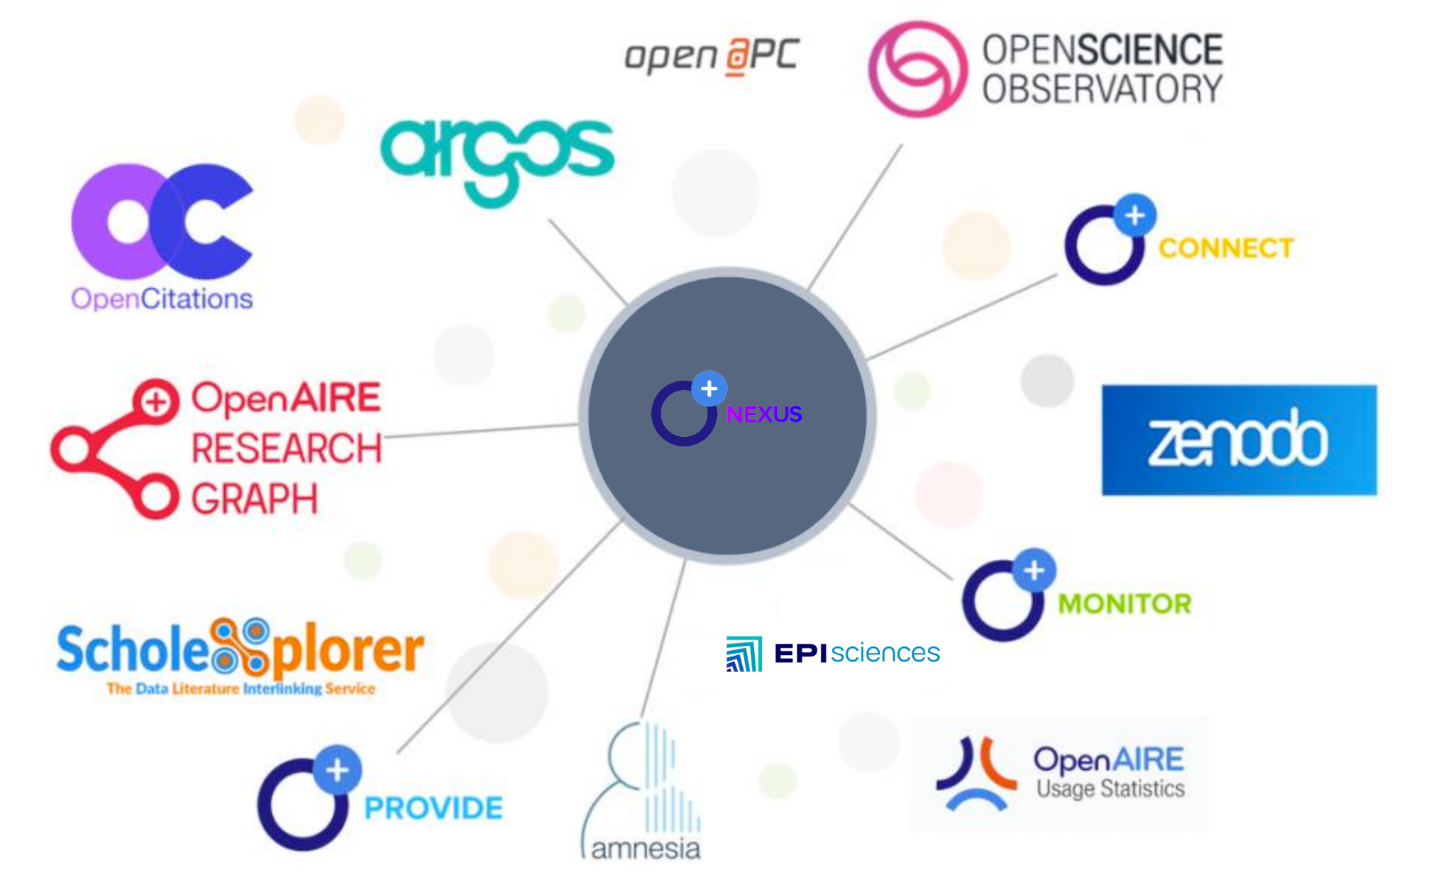


Connecting to OpenAIRE Nexus Services
Connecting to OpenAIRE Nexus / EOSC Services
Tools for publication and enrichment of metadata

Slide 7
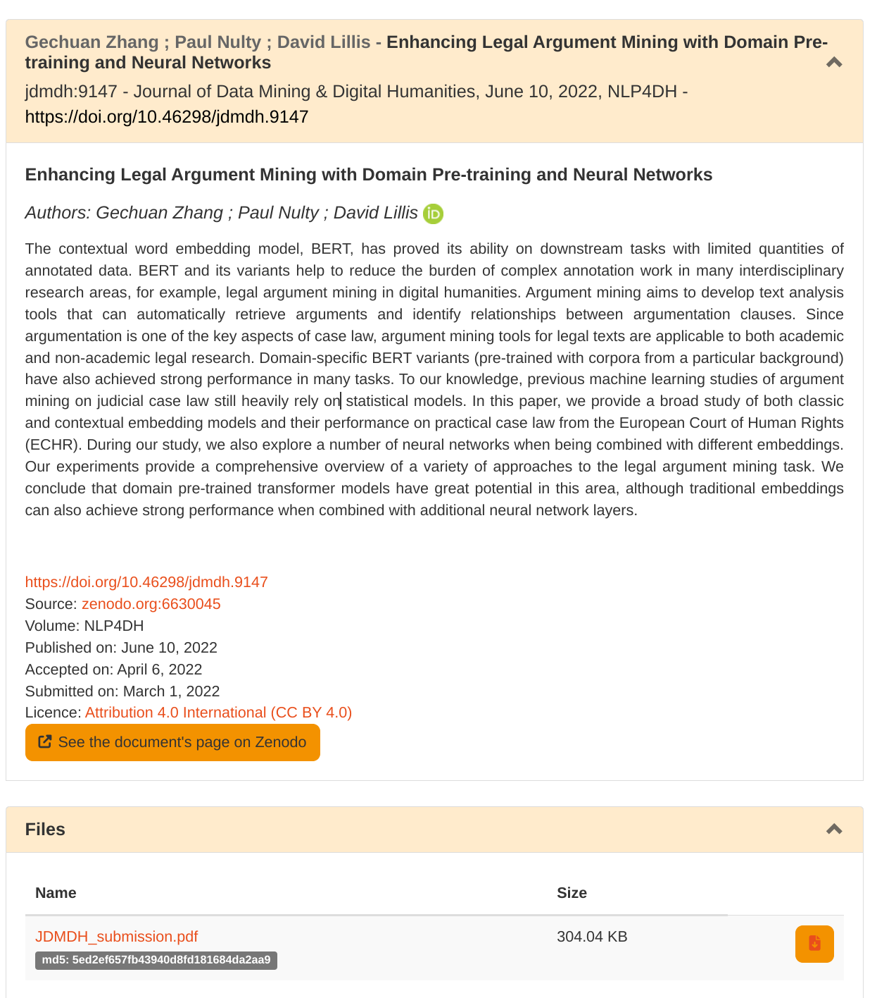
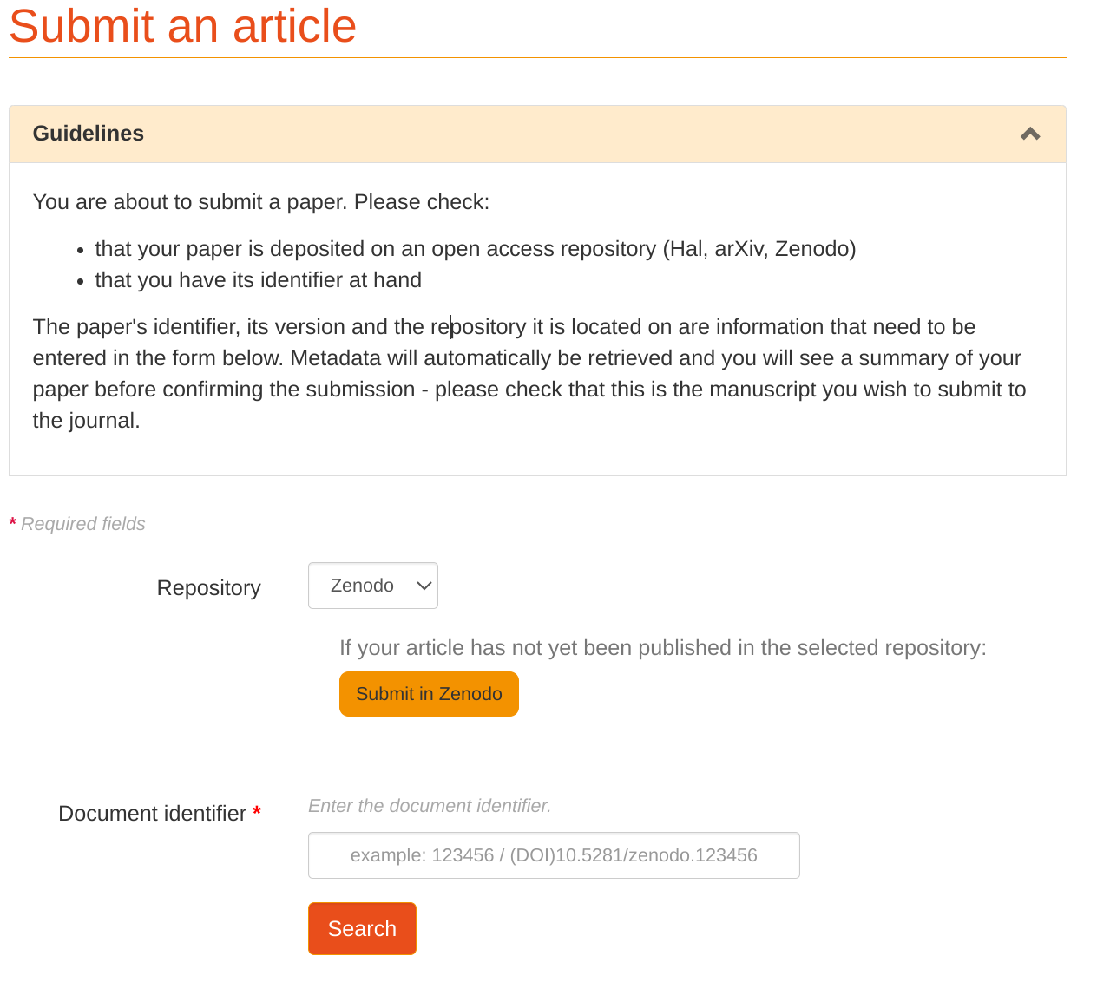

Connecting to OpenAIRE Nexus / EOSC Services
Zenodo

Slide 8


Connecting to OpenAIRE Nexus Services
Connecting to OpenAIRE Nexus / EOSC Services
Providing metadata to OpenAIRE
Harvesting content - OpenAIRE Guidelines

Slide 9
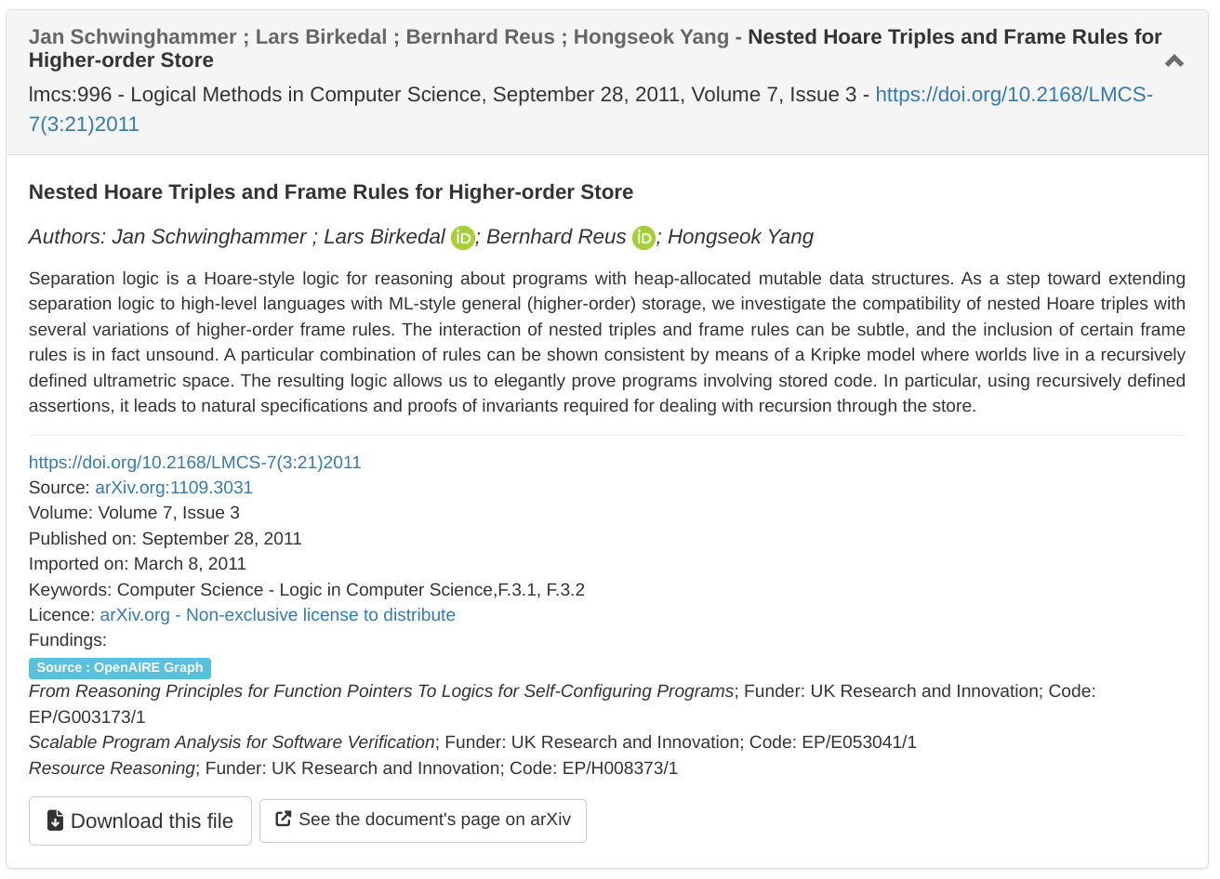
Connecting to OpenAIRE Nexus Services
Connecting to OpenAIRE Nexus / EOSC Services
Metadata enrichment (ORCID ; Funding)

Slide 10
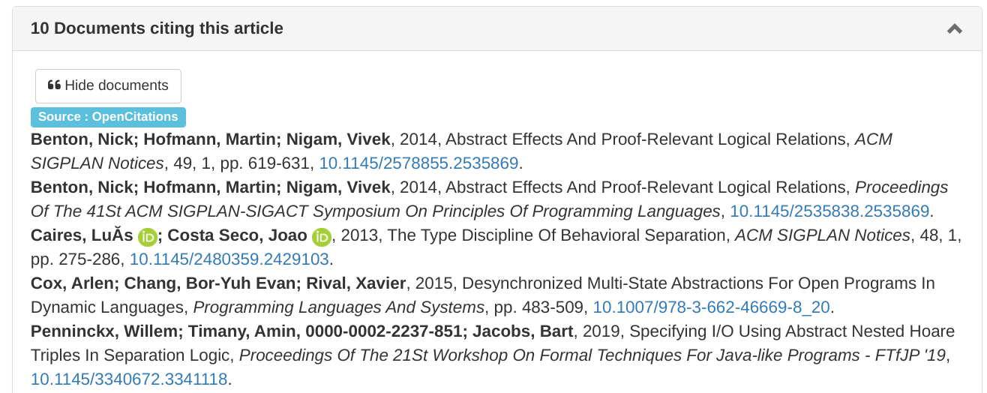

Connecting to OpenAIRE Nexus Services
Connecting to OpenAIRE Nexus / EOSC Services
Documents citing our publications

Slide 11
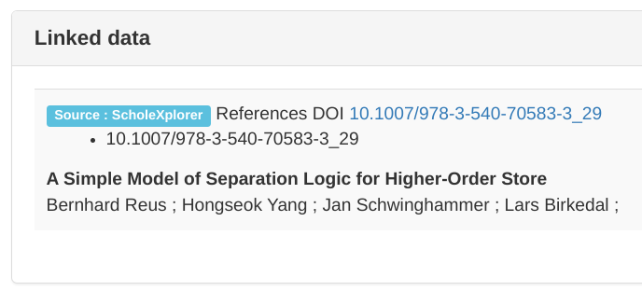

Connecting to OpenAIRE Nexus Services
Connecting to OpenAIRE Nexus / EOSC Services
Links between publications/datasets

Slide 12





Connecting to OpenAIRE Nexus Services
Episciences numbers
27 journals
> 11 000 submissions
> 5600 published articles
> 11 800 users
> 6 700 peer-review reports
> 2000 ORCID
> 8200 affiliations
> 900 ROR affiliations
> 1700 cited-by references
> 900 Linked publications/datasets
> 1300 projects/funders
> 3700 licences

Slide 13


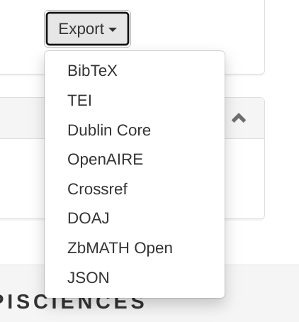

Connecting to OpenAIRE Nexus Services
OpenAIRE Nexus / EOSC - improving FAIR principles of published content
Distributing to other services
OAI-PMH harvesting OpenAIRE Guidelines
DOI metadata updates
DOAJ export format

Slide 14

Thank you
Raphaël Tournoy
raphael.tournoy@ccsd.cnrs.fr
More information on https://www.episciences.org/
https://github.com/CCSDForge/episciences

