Slide 1
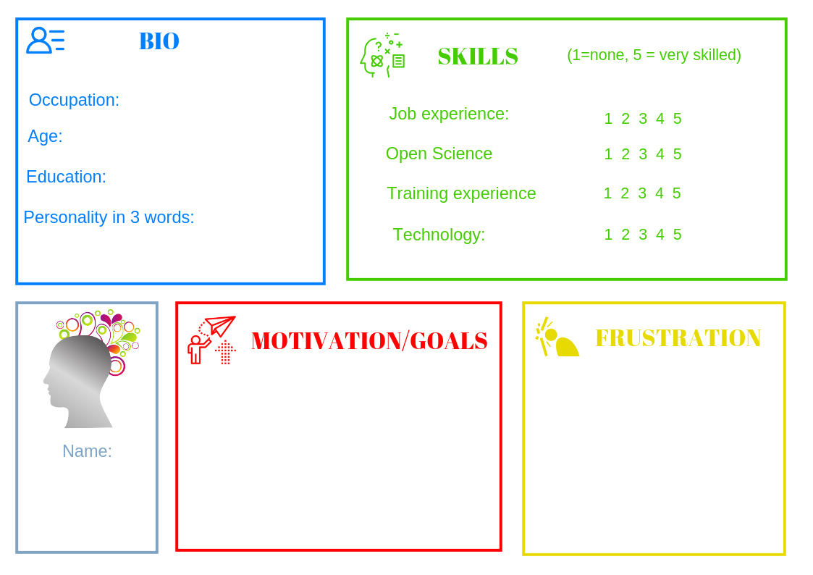
Design your training
TOPIC:
Choose
Create a PERSONA
Have a look at your Card:
AUDIENCE SIZE
AUDIENCE TYPE
KNOWLEDGE LEVEL
Present your plans (5 mins):
Learning outcomes
Structure
Materials
Exercise
...

Slide 2
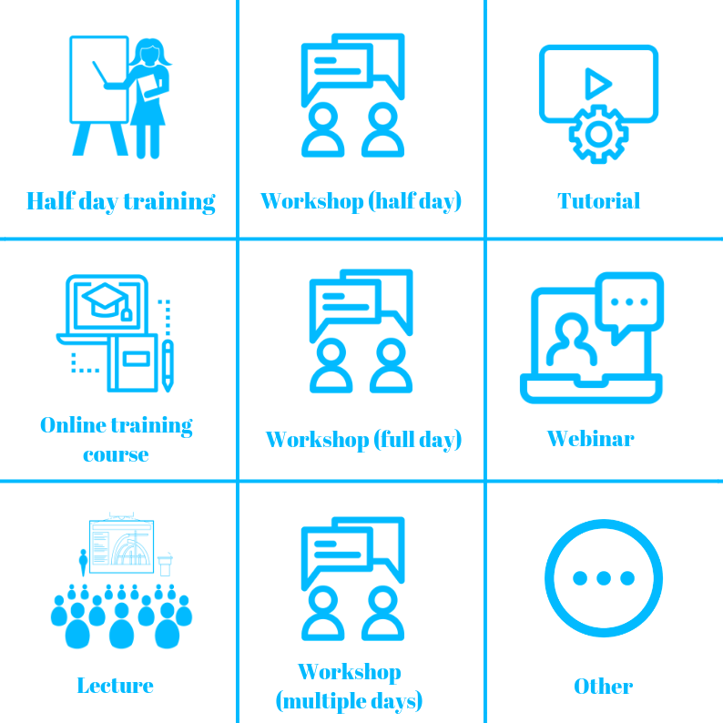
Training Format

Slide 3
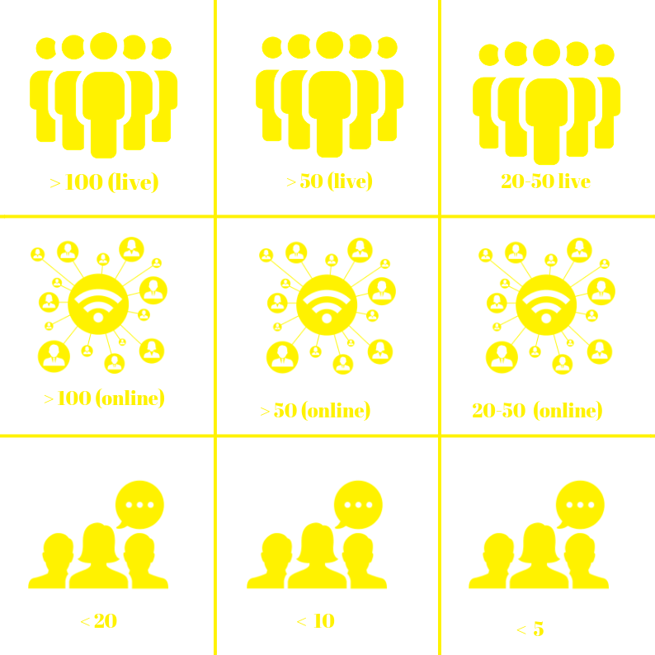
Audience SIZE

Slide 4
Audience TYPE

Slide 5
Knowledge Level

Slide 6
Your audience

Slide 7
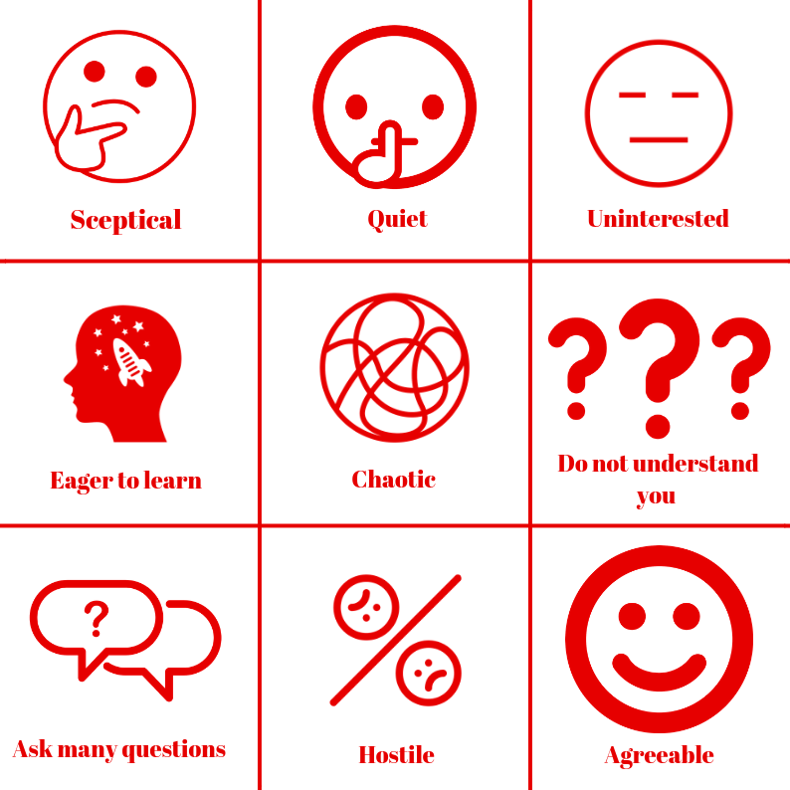
The Unpredictable: Audience Mood

Slide 8
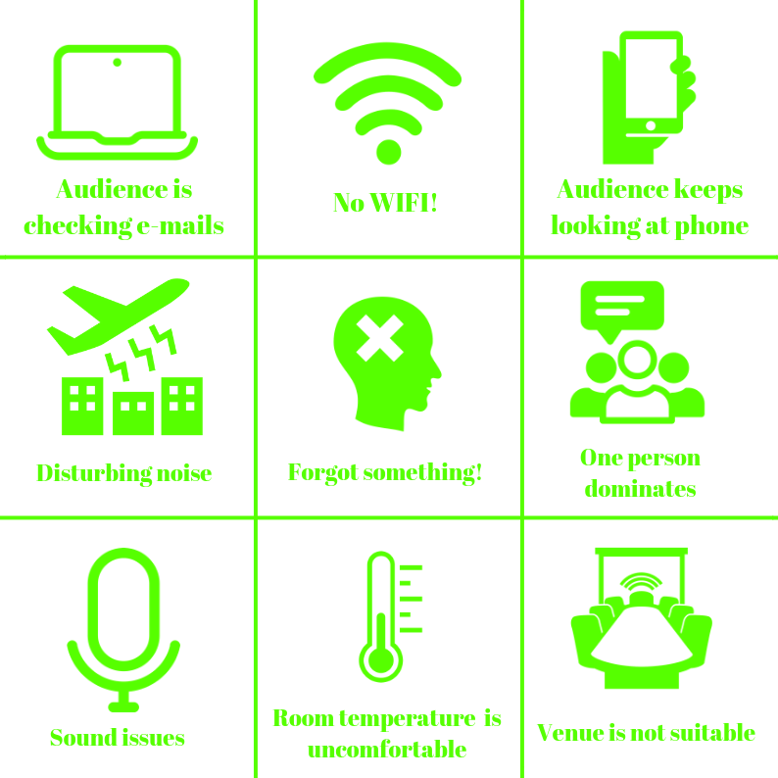
The Unpredictable: External factors

Slide 9
Design your training
Present your plans (5 mins):
Learning outcomes
Structure
Materials
Exercise
...
EVALUATION
Is the proposed training appropriate for audience size, type and level of knowledge?
Are the training materials adequate, understandable and accessible?
Troubleshooting:
AUDIENCE MOOD
DISTURBING FACTORS

Slide 10
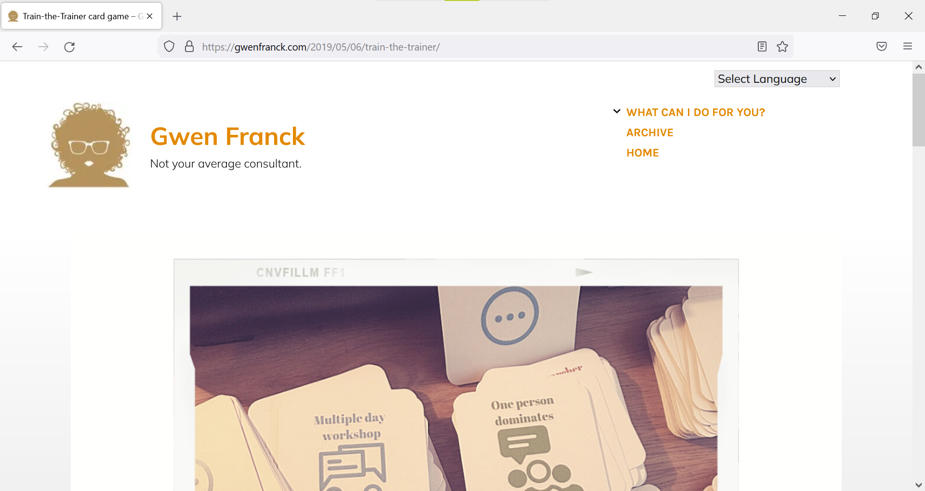
https://gwenfranck.com/2019/05/06/train-the-trainer

